Slide 1
Route map to greater ethnic diversity in the environment sector
Srabani Sen, CEO, Full Colour
October 2022
www.fullclr.com srabani.sen@fullclr.com

Slide 2
Why this work matters
Environment professionals are one of the least racially diverse professions in the UK, with just 4.81% identifying as Black, Asian or from other minority ethnic groups, compared to 12.64% across all UK professions.
Racial diversity in environment professionals, SOS, 2022

Slide 3
What we’ve developed
Overall objective: to change the world from within
Addressing barriers to recruitment and retention
Culture/ leadership
1 Uncovering the issues
What’s helping and hindering progress
2 Articulating a journey of change: the Route Map
3 Practical guidance

Slide 4
How we developed the Route Map
Phase 1: Research
Phase 2: Develop Route Map
Phase 3: Develop Guidance

Slide 5
Appetite and perception
Appetite vs Action Gap:
86% of leaders say increasing ethnic diversity should be a top or high sector priority, but only 22% feel it currently is
84% of organisations have considered the issues, but do not have a specific diversity action plan
Only 4% have an action plan that they consistently implement
Perception gap: 60% of CEOs say diversity is currently prioritised organizationally, compared to 38% of staff.

Slide 6
Organisational readiness

Slide 7
Racism
All POC Full Colour spoke to said there was overt/covert racism and unconscious bias in the sector
IES report
Stereotyping and discrimination
Exclusion from networks/ mentorship
Isolation, lack of voice
If you don’t address the barriers you won’t become diverse
Anti-blackness
Covert racism
Every day racism
Gaslighting/ racial gaslighting
Institutional/systemic racism
Microaggressions
Micro insults
Micro invalidations
Micro assaults
Overt racism
Model minorities (…pitting minorities against each other)
Unconscious bias

Slide 8
Challenges: revolutionary work
Needed to make choices to make the route map coherent
Not covered some issues E.g. “Downstream” issues, volunteers
Breadth of sector: size, focus, where orgs are on journey
Everyone needs something different
Consensus = impossible. NOTE: POC don’t have united view
Lack of POC in sector:
POC overburdened: hard to secure input

Slide 10
What’s the route map for (focus)
The route map will significantly contribute to:
Lowering barriers for people of colour joining, progressing and thriving in the sector
Cultivating a genuinely inclusive culture within each organisation and across the sector
Increasing ethnic diversity within the sector

Slide 11
Who?
Clear, visible and significant change could be made by focusing on:
Increasing the ethnic diversity of staff and leaders
Addressing the culture of organisations and the sector
Leaders, HR professionals and managers have the most influential role to play and therefore the actions devised relate to what they can do.
People of colour also have a clear role to play as they choose – driving change v not overburdening

Slide 12
Summary of route map

Slide 13
3 phases of journey to long term change

Slide 14
Four categories of milestones
Evolving culture
Y1:Definitions, equipping leaders/managers/HR, commit to action
Beginning to address racism and enabling people of colour to progress
Y1: Understanding POC experience, establishing structured support for POC, reporting racism
Increasing ethnic diversity
Y1: Benchmark data (Race Report),
Embedding action
Y1: Sector learning est’d, orgs develop change plans

Slide 15
Guidance manual chapters
Key terms
Roles of leaders, managers and HR/Learning and Development Practitioners
Making a public commitment to action
Developing an action plan
Sharing your vision, actions and progress
Working with people of colour in your organisation to define the role they want to play in driving change
Developing guidance on inclusive behaviours
Beginning to address racism and enabling people of colour to progress
Debiasing recruitment
Other policies to consider
Resources and specialist agencies

Slide 16
E.g. Roles of leaders, managers, HR/L&D
Learn
Be and hold others accountable
Set/share vision
Role
Monitor/ act/report on data
Set/manage resources

Slide 17
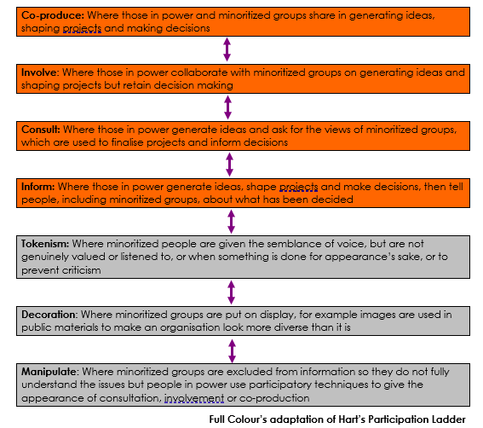
E.g. How people of colour can define the role they want to play
Practical considerations
Emotional considerations
Assumptions
Support

Slide 18
E.g. Making commitment to action
Discussion points for trustees and senior leaders
Approaches to developing an organisation specific vision
How and to whom to communicate your vision and commitments
This guidance manual holds your hand

Slide 19
Finally…
Full Colour: “We’re not here to judge, we are here to help”
For the 84%
Clear journey of change that you can apply in your organisation and understand your contribution to sector change
Practical steps to take
Aim is to take away the uncertainty of where to start

Slide 20
Thank you
These slides, the reports, and guidance resources can be found at:
www.wcl.org.uk/ethnic-diversity-route-map-resources.asp
Srabani Sen OBE
srabani.sen@fullclr.com
www.fullclr.com

